Slide 1
Web and mobile app development – csc3054/7054
9.3 Smartphone web development

Slide 2
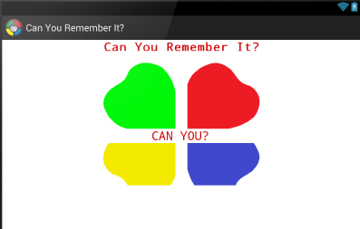
“simon says game” application
A random order is shown to the user who has to correctly press the order previously presented.
Different difficulty levels.

Slide 3
What we discussed in the last lecture?
Links and access keys
CSS for mobile devices
Wireless markup language
PHP and basics

Slide 4
Learning outcomes
To introduce the basic structure of a social network.
To explain the flowchart of a server-client communication system.
To understand how to apply PHP onto the server.
To understand how the client side works.

Slide 5
Content outline
Social networking service
Example of server-client communication
AndroidListServer
Client
Summary
Next lecture
Further readings

Slide 6
What is social networking service?
An online service, platform, or site that facilitates the social relations among people who can share interests, activities, background or real-life connections.

Slide 7
Components of a social networking service
A representation of each user (a profile).
His/her social links.
Web-based services, e.g. e-mail and instant messaging.

Slide 8
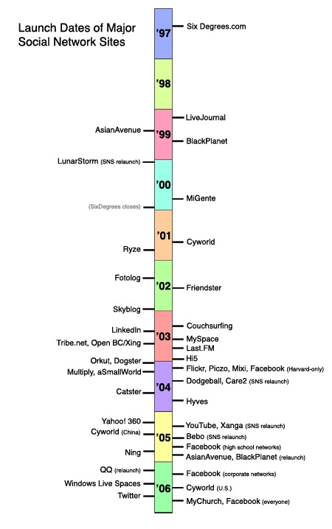
Timeline of the launch of major social networking sites:

Slide 9
To build a social network
To make a server where the data can be saved, e.g. MySQL/SQLite.
To make an API to add data to that server, e.g. an PHP API for a small network.
To write an app to send a request through the API and saves the action to the database.
Other users can get information through the API from the same database.

Slide 10
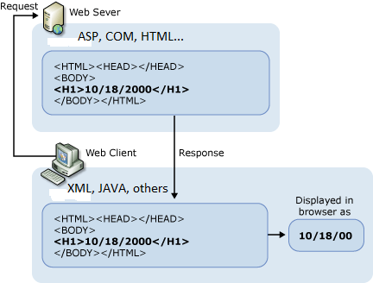
Illustration of server-client connection

Slide 11
Further explanations
ASP: Active Server Pages, Microsoft's first server-side script engine for dynamically generated web pages.
Initially released as an add-on to Internet Information Services (IIS) via the Windows NT 4.0 Option Pack (ca. 1996), it was subsequently included as a free component of Windows Server.

Slide 12
Content outline
Social networking service
Example of server-client communication
AndroidListServer
Client
Summary
Next lecture
Further readings

Slide 13
Example of server-client communication
To retrieve a list of animals from the server and then display it on the client.
When the user selects an animal from the list, the app will retrieve the sound of the animal from the server and also display it on the client.

Slide 14
Technical implementation
The client has an Android app, whilst the server is a PHP script.
Use a HTTP POST method (instead of GET) and return data as a string:
This is one of the most commonly used methods for submitting data to a web server.
HTTP POST allows posting messages to bulletin boards, mailing lists and newsgroups.
HTTP POST responses are not cacheable unless they contain appropriate headers.

Slide 15
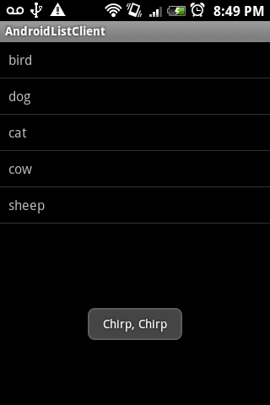
Display on the client

Slide 16
Content outline
Social networking service
Example of server-client communication
AndroidListServer
Client
Summary
Next lecture
Further readings

Slide 17
AndroidListServer
The server is a simple PHP script that supports two commands:
getAnimalList
getAnimalSound

Slide 18
AndroidListServer
getAnimalList:
Parameters: none.
Returns: a comma separated list of animals.
getAnimalSound:
Parameters: none.
Returns: string representation of the sound of the animal.

Slide 19
Server.php
<?php // get the command
$command = $_REQUEST['command']; // determine which command will be run
if($command == "getAnimalList") { // return a list of animals
echo "bird,dog,cat,cow,sheep";
} else if($command == "getAnimalSound") { // get the animal parameter and send the right response
$animal = $_REQUEST['animal'];
if($animal == "bird") {
echo "Chirp, Chirp";
} else if($animal == "dog") {
echo "Woof, Woof";
} else if($animal == "cat") {
echo "Meow, Meow";
} else if($animal == "cow") {
echo "Moo, Moo";
} else if($animal == "sheep") {
echo "Baa, Baa";
} else {
echo "I don't know.";
}
} else {
echo "";
}
?>

Slide 20
Content outline
Social networking service
Example of server-client communication
AndroidListServer
Client
Summary
Next lecture
Further readings

Slide 21
Client
The Android app includes two classes:
ServerInterface.
AndroidListClient (a ListActivity).

Slide 22
Serverinterface
To initialise communication with the server.
To make an HTTP request to the server.
To send parameters as POST data.
To get a response and return it as a string.

Slide 23
AndroidListclient
onCreat() is called when the activity is first created;
Initialise the list;
Supply the data structure needed;
Set up an item click listener to retrieve the animal sound and display;
Launch a GetAnimalSoundTask thread to collect data from the server;
Produce a GetListTask thread to get data from the server;
Implement an asynchronous retrieval of the list from the web that uses the AsyncTask class;
Make the http request and return the result as a String;
Parse the String result, and create a new array for the list;
Make a thread to retrieve the animal sound;
Display the result as a Toast.

Slide 24
To run the code
Before running this code, make sure to give the app permission to access the INTERNET.
This can be done by adding the following entry to the AndroidManifest.xml file:
<uses-permission android:name
="android.permission.INTERNET"></uses-permission>

Slide 25
Content outline
Social networking service
Example of server-client communication
AndroidListServer
Client
Summary
Next lecture
Further readings

Slide 26
Summary
Introduced basic concepts and make-up of social network.
Introduced the sever-client communication system, including server and client.
Described the communication between the two ends.

Slide 27
Content outline
Social networking service
Example of server-client communication
AndroidListServer
Client
Summary
Next lecture
Further readings

Slide 28
next lecture
To optimise resources for smartphone web development.

Slide 29
Content outline
Social networking service
Example of server-client communication
AndroidListServer
Client
Summary
Next lecture
Further readings

Slide 30
Further readings
http://www.hassanpur.com/blog/2010/09/android-development-implementing-a-simple-client-server-model/

